Slide 1

Basic Details of the Team and Problem Statement
Ministry/Organization Name/Student Innovation:
PS Code: SIH1454
Problem Statement Title : Create an intelligent system using AI/ML to detect phishing domains which imitate look and feel of genuine domains
Team Name : Ethical Encoders
Team Leader Name : Pramoth K J
Institute Code (AISHE):
Institute Name: Sri Eshwar College of Engineering
Theme Name: Blockchain & Cybersecurity

Slide 2
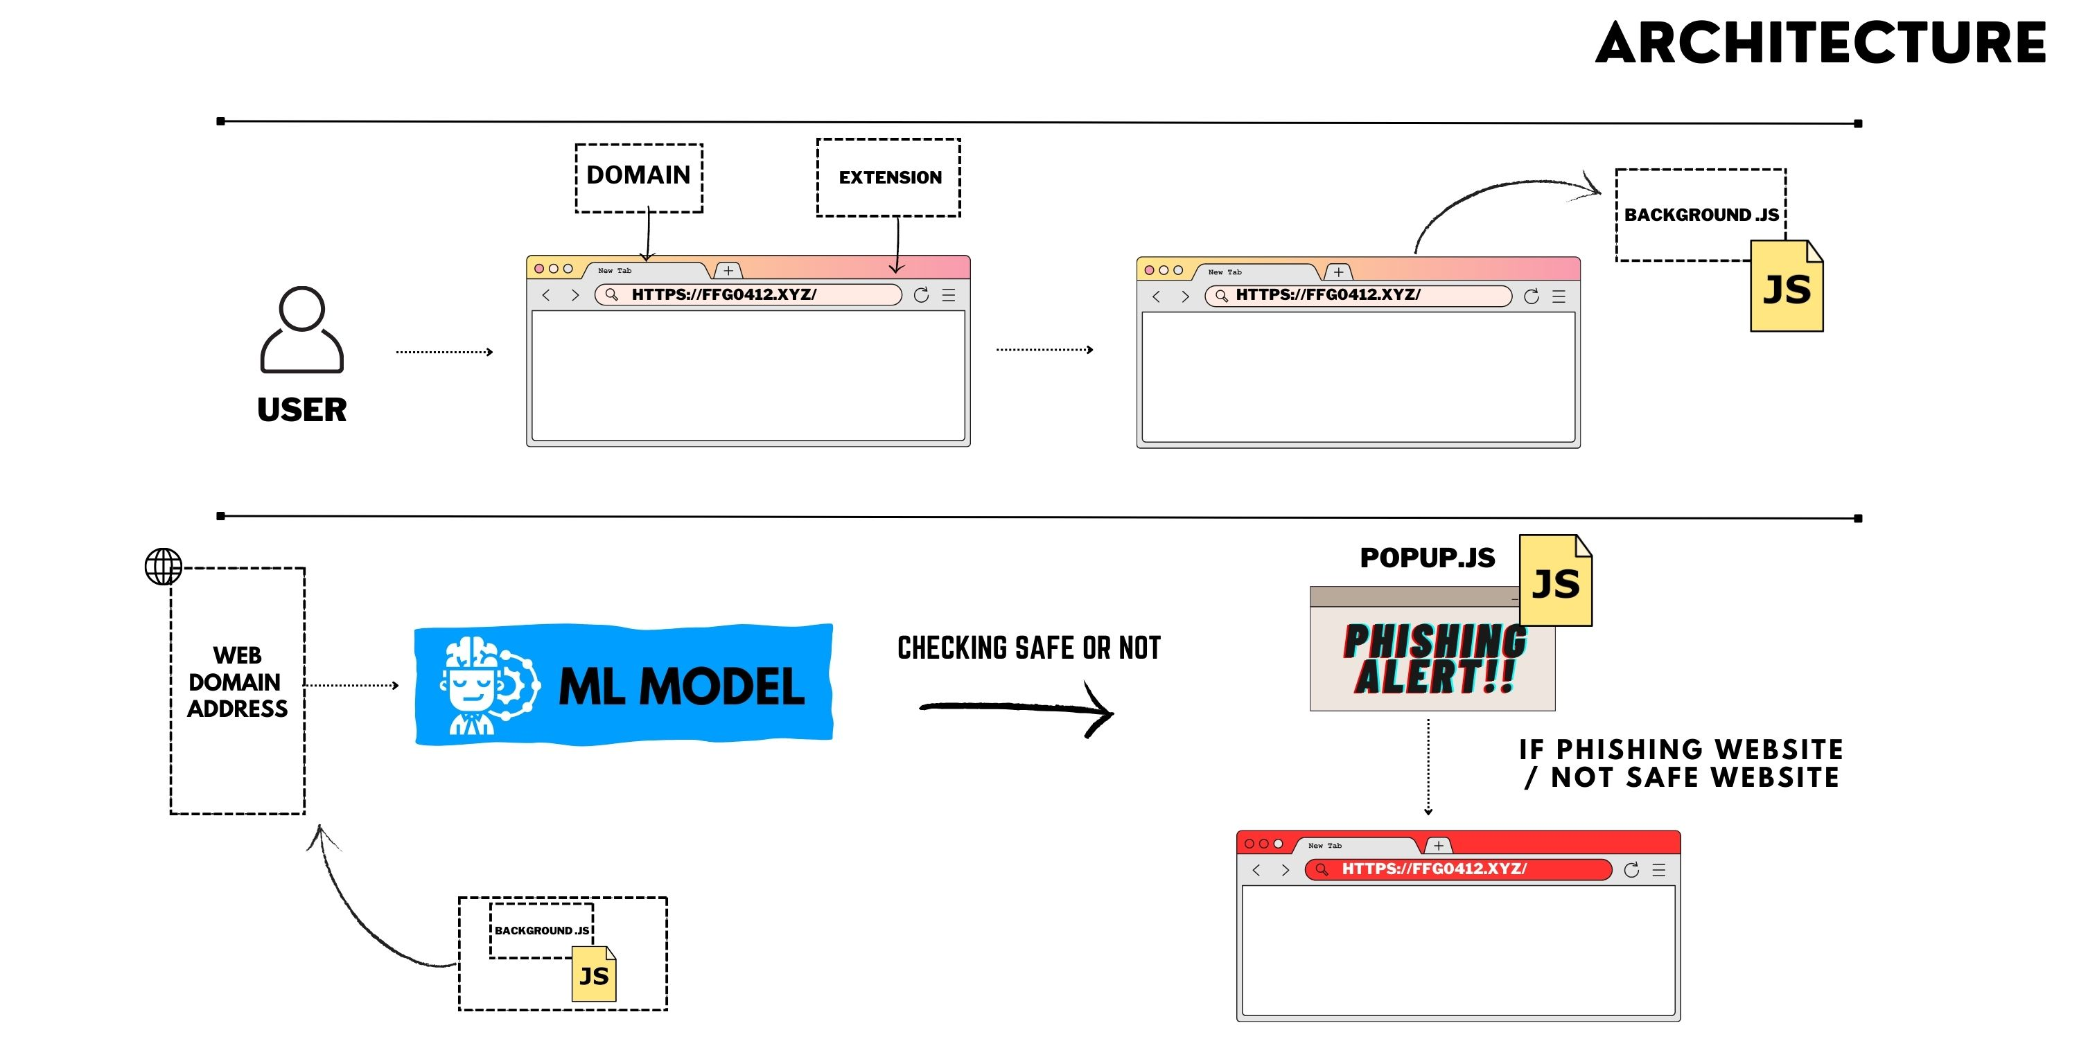
Idea/Approach Details
Describe your idea/Solution/Prototype here:
Development of Browser Extension-(PhishGuard AI)
Extension that leverages a pre-trained machine learning model, specifically a Convolutional Neural Network (CNN), to detect phishing websites.
This model has been trained on a vast dataset containing both phishing and benign URLs.
Our extension actively scans URLs in real-time and promptly alerts you with a pop-out message if it detects a potential phishing website.
This detection process occurs seamlessly, enhancing online security without user intervention.
Describe your Technology stack here:
Python
Deep learning algorithm – CNN
XGBooster
HTML5 CSS3
Javascript

Slide 3
Idea/Approach Details
Describe your Use Cases here
Describe your Dependencies / Show stopper here
1. Financial Transaction Security : Enhance online payment and financial platform security by detecting and halting phishing attempts, safeguarding user payment information.
2. E-commerce Protection: Block counterfeit e-commerce sites, ensuring safe online shopping experiences, and preventing fraudulent purchases.
3.Online Shopping Verification : Boost confidence in online shopping by verifying store authenticity, reducing the risk of scams.
4. Online Banking Security: Protect financial credentials, verify genuine bank websites, and prevent phishing attacks.
Python: The primary language for extension development and machine learning.
Deep Learning Framework: Choose TensorFlow, PyTorch, or Keras for building and training the CNN model.
Web Development Skills: JavaScript, HTML, CSS
Phishing Dataset: Gather data from sources like PhishTank or OpenPhish, containing known phishing and legitimate websites

Slide 4
Team Member Details
Team Leader Name: Pramoth K J
Branch :B Tech Stream : AIDS Year : III
Team Member 1 Name: Gowtham S
Branch :B Tech Stream : AIDS Year : III
Team Member 2 Name: Vidya sagar M
Branch :B Tech Stream : AIDS Year : III
Team Member 3 Name: Dharaneesh S
Branch :B Tech Stream : CSBS Year : III
Team Member 4 Name: Mohanapriya A
Branch :B Tech Stream : AIDS Year : III
Team Member 5 Name: Nesha S B
Branch :B Tech Stream : AIDS Year : III
Team Mentor 1 Name: Dr S Sumathi
Category : Academic Expertise : AI ML Domain Experience (in years): 12
Team Mentor 2 Name: Mrs B Suchithra
Category : Academic Expertise : Cybersecurity Domain Experience (in years): 9

